Slide 1
The Effects on the Period of Compound Pendulum due to Liquid Damping
Jintian Wang

Slide 2
CONTENTS
Background
Objectives
Research Process
Timeline

Slide 3
BACKGROUND
Pendulum is important
Simple pendulum?
Compound pendulum?
With damping
Not major
Ideal model
Liquid

Slide 4
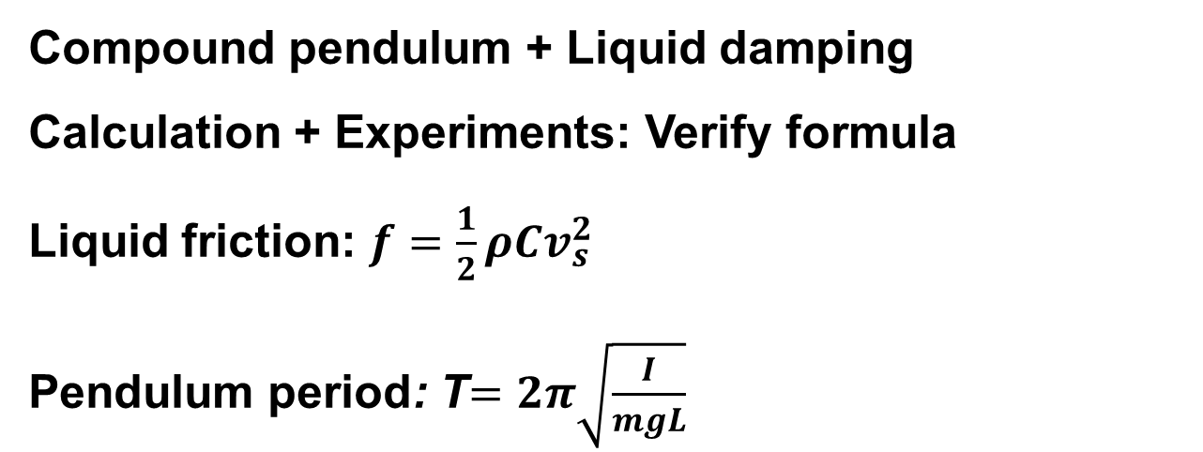
OBJECTIVES
Compound pendulum + Liquid damping
Calculation + Experiments: Verify formula
Liquid friction: $f=\frac{1}{2}ρCv_{s}^{2}$
Pendulum period: T$=2π\sqrt{\frac{I}{mgL}}$

Slide 5
RESEARCH PROCESS
Basic assumptions
Cross area: a square
g value constant
No extension
Be soaked in liquid
No rolling friction
Same type of liquid: water
Research method
Quantitative research, Control Variables Method
Resource needed
Mainly from websites

Slide 6
RESEARCH PROCESS
1. Read papers.
2. Deduce formula.
extreme, normal, and boundaries
3. Experiment.
Design, list cautions
4. Analyze data.
plot data, draw formula answers, compare
5. Conclude.
Mistakes? How to improve?

Slide 7
TIMELINE
2023.09-10:
Collect references, work out the first version of formula about the pendulum
2023.12-24.01:
Design experiment, make theorical expectations, calculate various answers
2024.03-04:
Analyze data, finish the essay, submit to tutor for final revision
2023.07-08:
Determine research topic, make the first step to the question,
have a basic understanding
2023.11-12:
Study how to plot graph and how to meet the needs of experiments(e.g. python+3d design)
2024.01-02:
Complete experiment, check if any mistakes,
Draw graphs and compare the expectations with reality

Slide 8
Thank you for your listening

